Slide 1
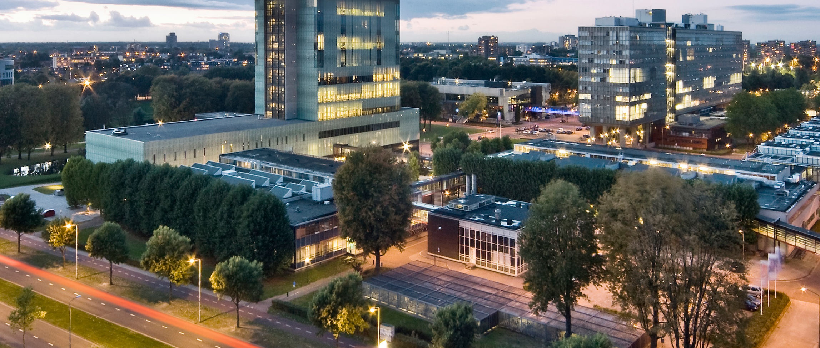
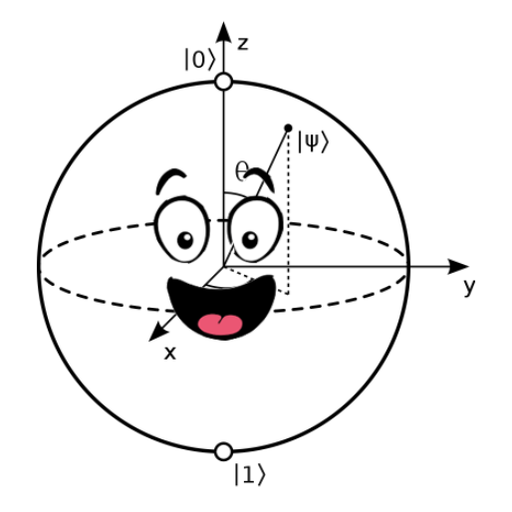
Quantum computing in the noisy intermediate-scale quantum (NISQ) era
Lecture 2: Neutral Atom Quantum Computing
Robert de Keijzer, r.j.p.t.d.keijzer@tue.nl

Slide 2
Download from: bit.ly/43blrmh
Unpack the Ottawa_QC_Wokrhsop.zip file somewhere you can access
If you don’t have it yet, download Anaconda from https://www.anaconda.com/products/distribution
When installed, open the Anaconda Prompt terminal (from your searchbar or any other way) (if you have linux or iOS, run the code below from your regular terminal)
Create a new conda environment (for instance with name “CASA_workshop”) with the command
conda create --name Ottawa_QC
5. Activate the environment using
conda activate Ottawa_QC
Install pip using:
conda install pip
7. Install packages using
pip install jupyter
pip install qutip
pip install matplotlib==3.4
8. Open Jupyter using
jupyter notebook
9. Navigate to the directory you unpacked the zip file

Slide 3

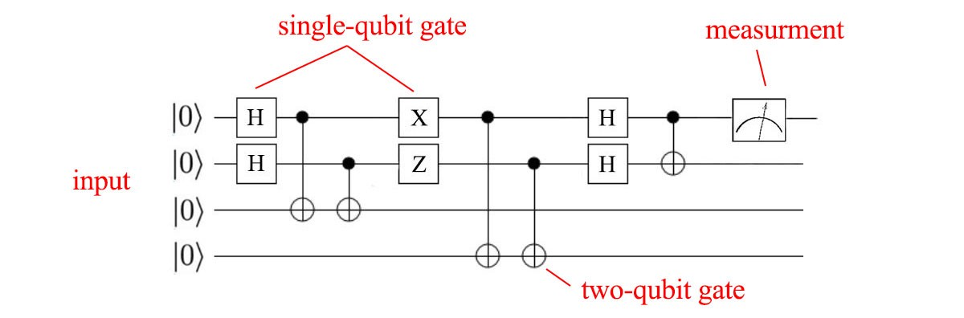
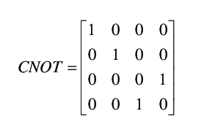
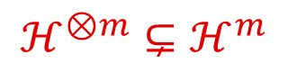

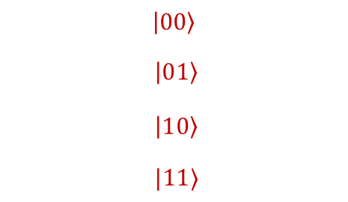
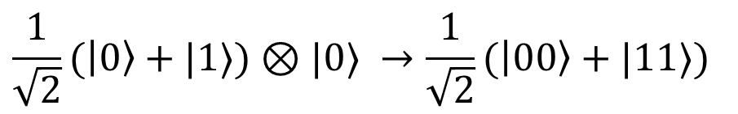
Recap: quantum circuit diagrams
Quantum Gates
$$|00〉 |01〉 |10〉 |11〉$$
CNOT gate
$$|00〉$$
$$|01〉$$
$$|10〉$$
$$|11〉$$
Can take product state to entangled state
$$ℋ^{⊗m}⊊ℋ^{m}$$
$$\frac{1}{\sqrt{2}}(|0〉+|1〉)⊗|0〉 →\frac{1}{\sqrt{2}}(|00〉+|11〉)$$

Slide 4
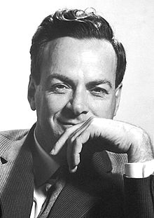
History of Quantum Computing
Proposed in 80s by Richard Feynman
Quantum algorithms design, early 90s
Deutsch algorithm (1985)
Grover’s algorithm (1996)
Shor’s algorithm (1994)
Quantum error correction (1996, Knill & Laflamme)
Technological advantages led to possibility of controlling quantum systems (early 2000)
Noisy Intermediate Scale Quantum era
“Nature isn't classical, dammit, and if you want to make a simulation of nature, you'd better make it quantum mechanical, and by golly it's a wonderful problem, because it doesn't look so easy.”
First proposal (1981)
First realized quantum systems (2000)
Universal QC
Quantum Algorithms (1980’s)
Quantum error correction (1986)
NISQ

Slide 5
History of Quantum Computing
Proposed in 80s by Richard Feynman
Quantum algorithms design, early 90s
Deutsch algorithm (1985)
Grover’s algorithm (1996)
Shor’s algorithm (1994)
Quantum error correction (1996, Knill & Laflamme)
Technological advantages led to possibility of controlling quantum systems (early 2000)
Noisy Intermediate Scale Quantum era
“Nature isn't classical, dammit, and if you want to make a simulation of nature, you'd better make it quantum mechanical, and by golly it's a wonderful problem, because it doesn't look so easy.”
First proposal (1981)
First realized quantum systems (2000)
Universal QC
Quantum Algorithms (1980’s)
Quantum error correction (1986)
NISQ

Slide 6
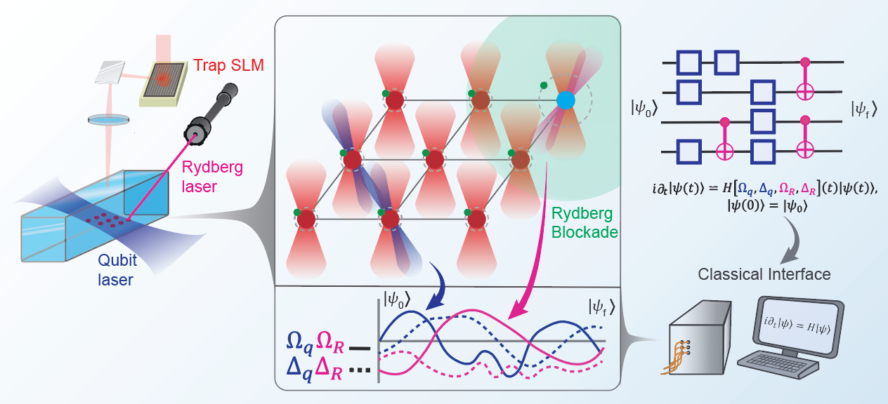
Today
Creating a Rydberg system
Dynamics in Rydberg Systems

Slide 7
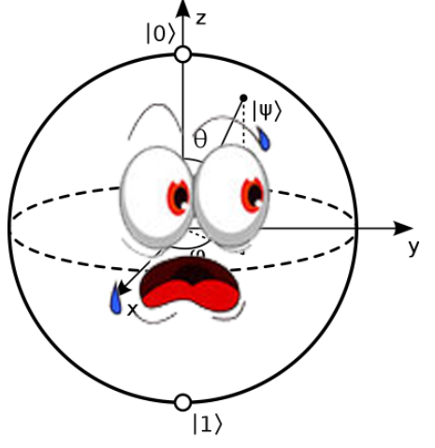

Today
a lot of
Physics

Slide 8
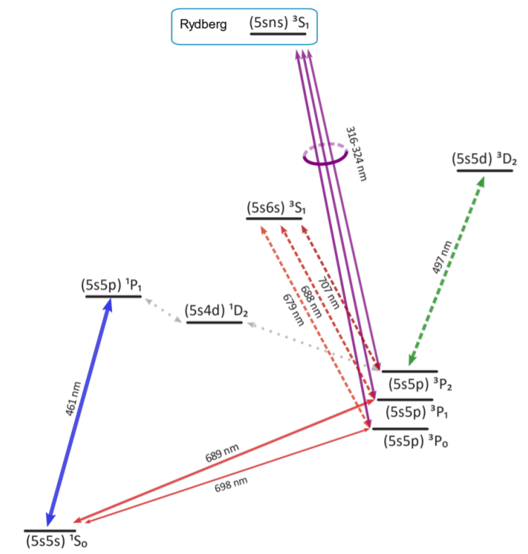
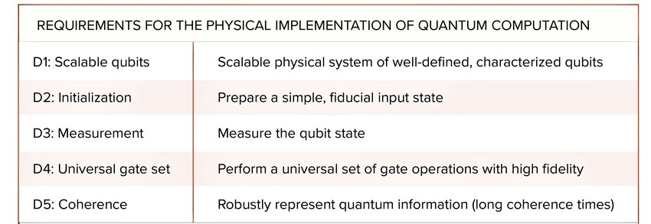



Rydberg physics
DiVincenzo criteria (2000):
$$|r〉$$
Why neutral atoms:
Scalability only limited by power (D1)
Easy controllable, technique well developed for atomic clocks (D2 & D3)
Long range interactions (D4)
Long lived qubits (2 min for Sr88) (D5)
$$|1〉$$
$$|0〉$$

Slide 9
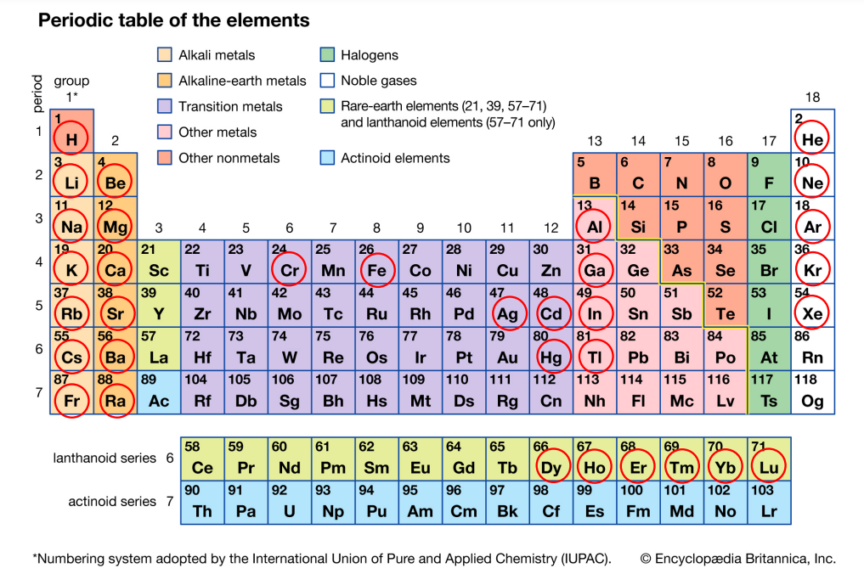
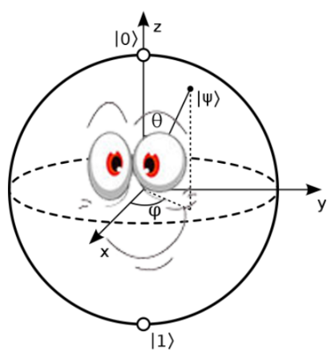
Laser cooled atoms

Slide 10
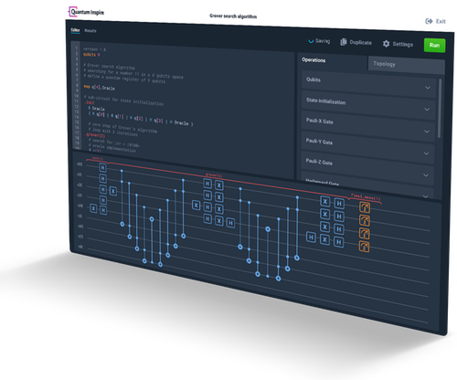
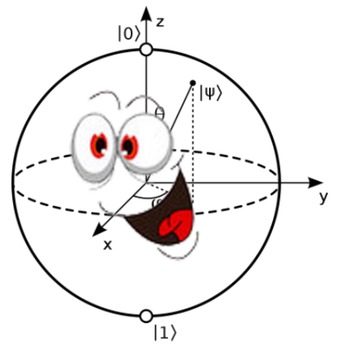
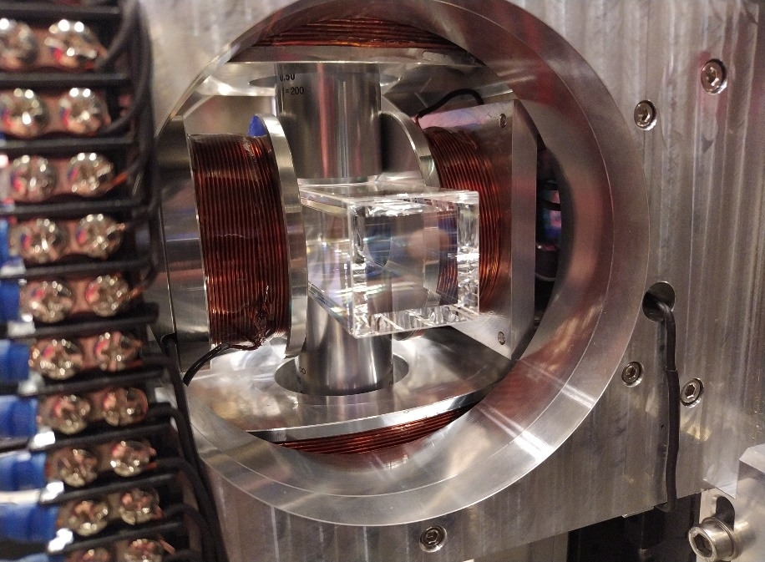
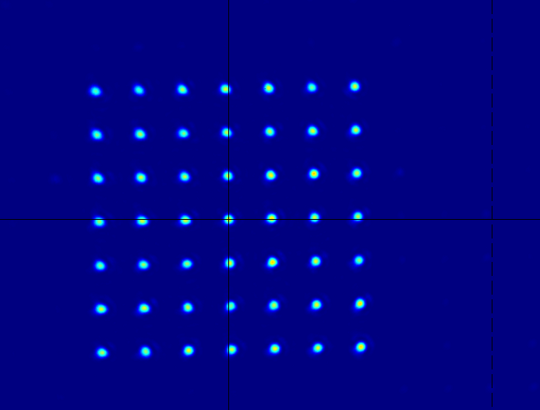
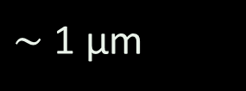
Demonstrator - Rydberg hybrid quantum computer
Eindhoven KAT-1 project, Quantum Delta NL
Setup Rydberg platform as a robust demonstrator
Quantum Inspire with 24/7 online access,
system for hybrid classical-quantum calculations
$\sim$ 1 μm
Notes:
Other Image

Slide 11
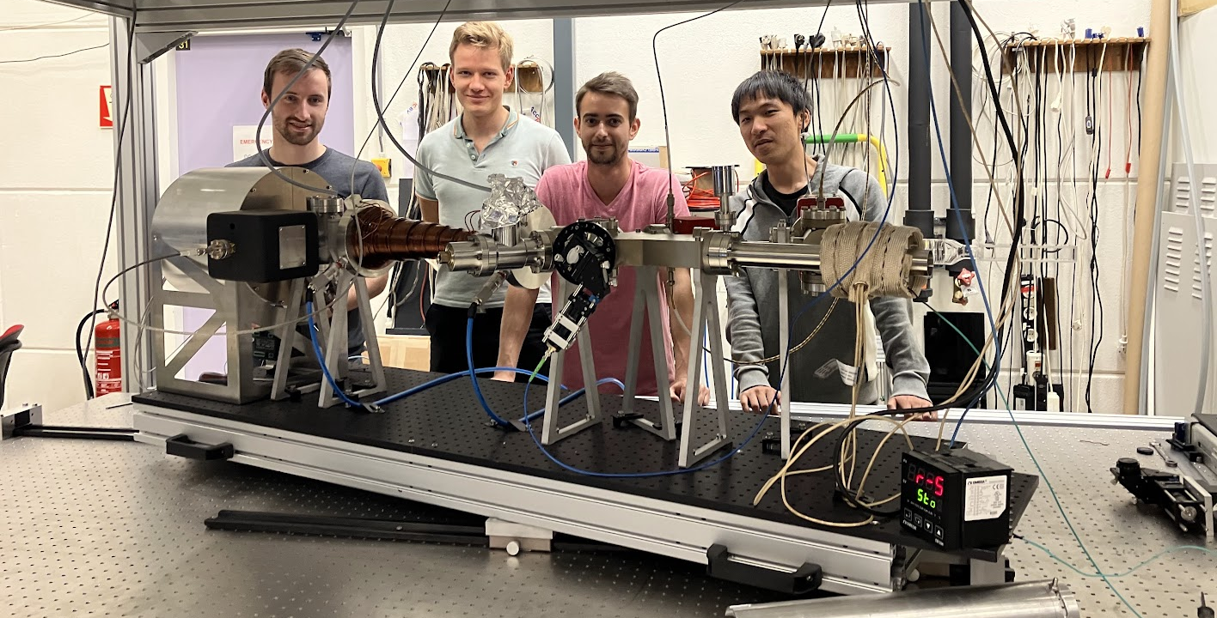
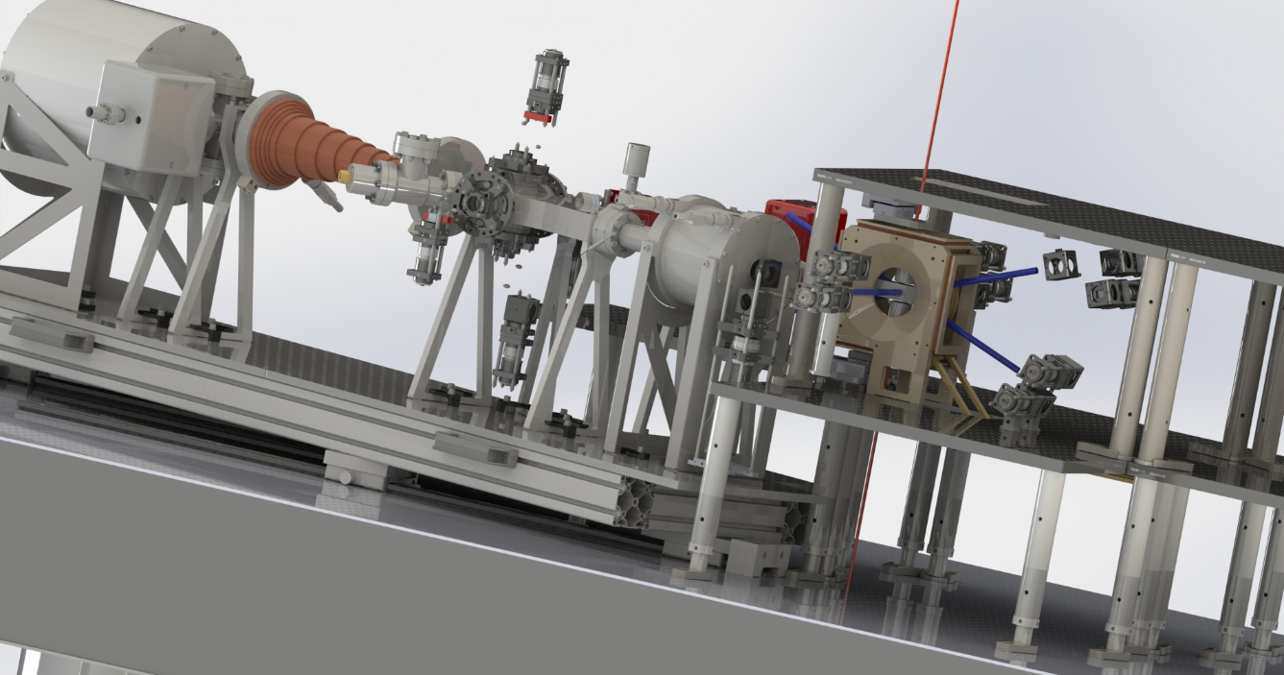
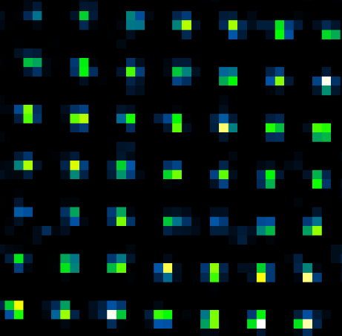
Rydberg Quantum Computing
Single atom loading in KAT-1
Eindhoven (Rb-85)
Sorting grids (Rb-85)
Loading MOT (Sr-88)
Single site control in coming months
11

Slide 12
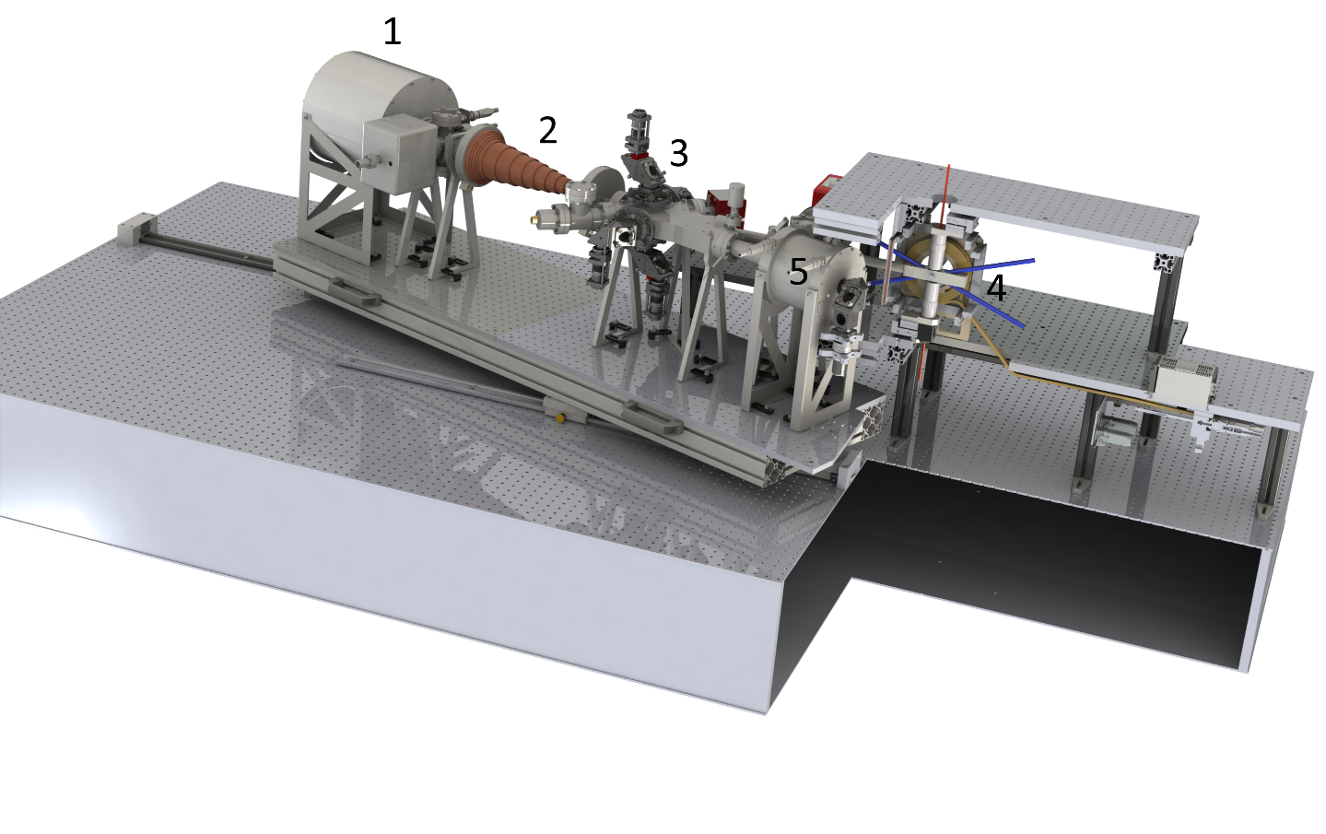
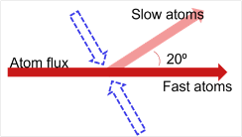
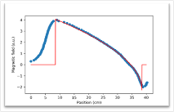
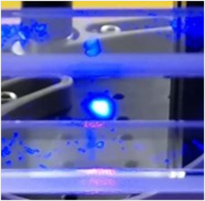
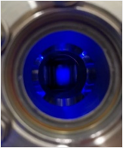
The experiment
Oven
Slower
Deflection stage
Glass cell
Heated window
1
2
3
4
5
Notes:
This is what the machine looks like right now
Oven→glass cell
Vacuum pumps .. ~10^-11 mbar differential pumping
To go a bit more in depth … go into parts

Slide 13
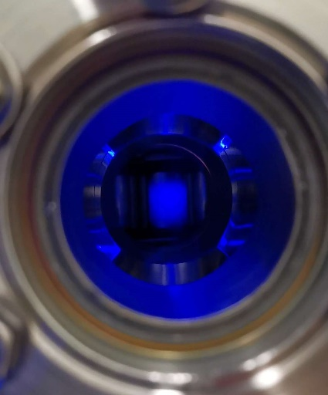
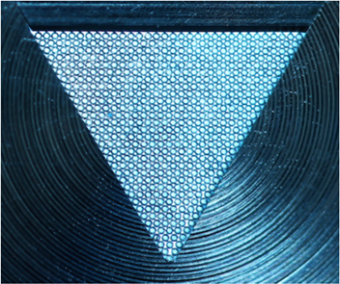
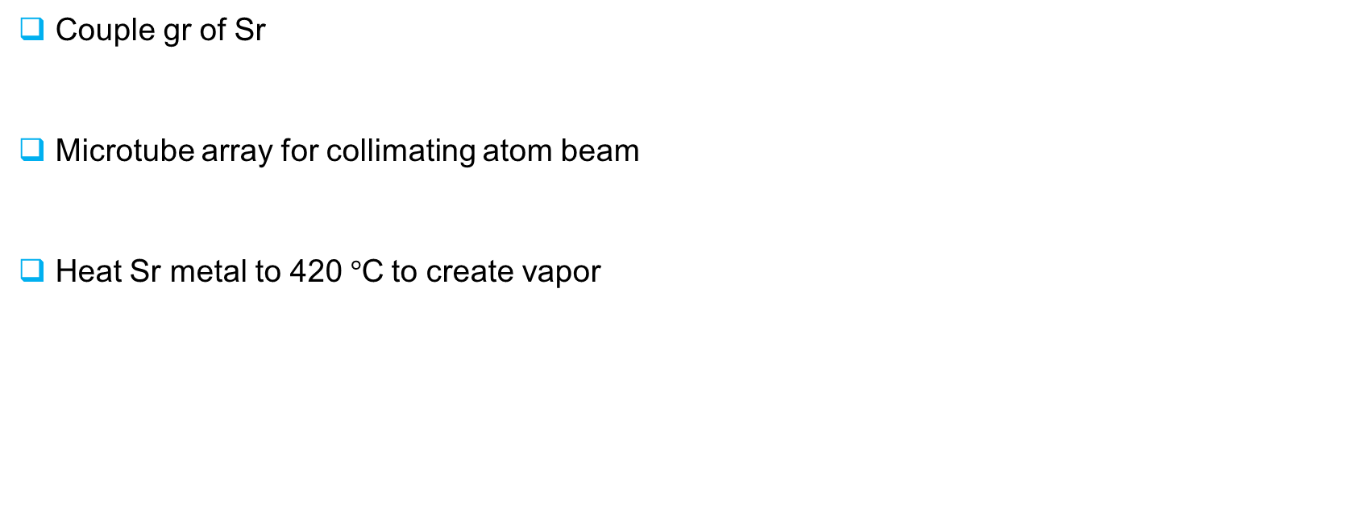
Oven
Couple gr of Sr
Microtube array for collimating atom beam
Heat Sr metal to 420$°$C to create vapor
laser
atoms

Slide 14
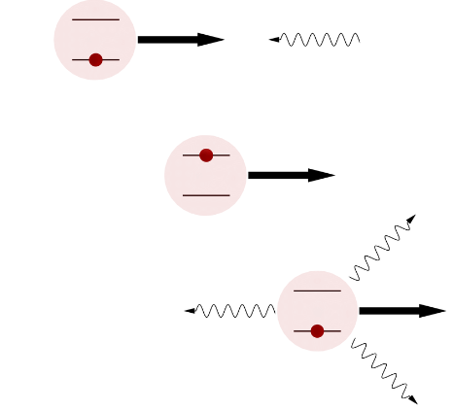
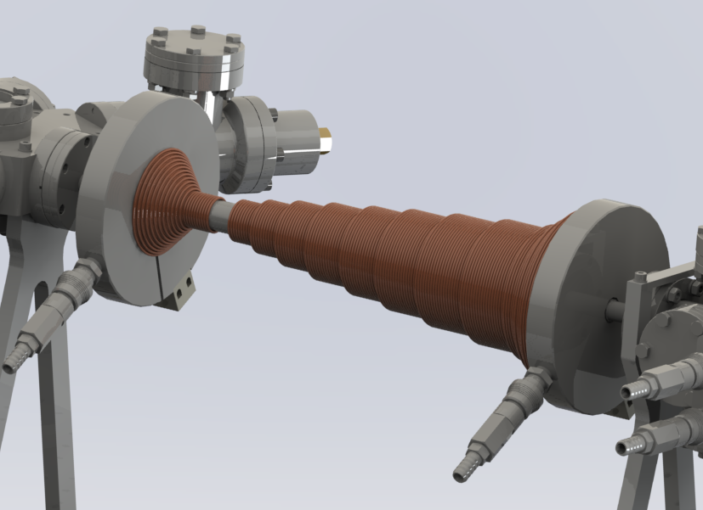
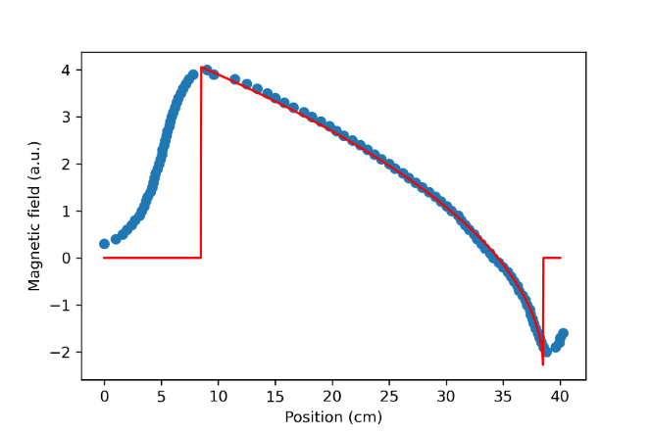
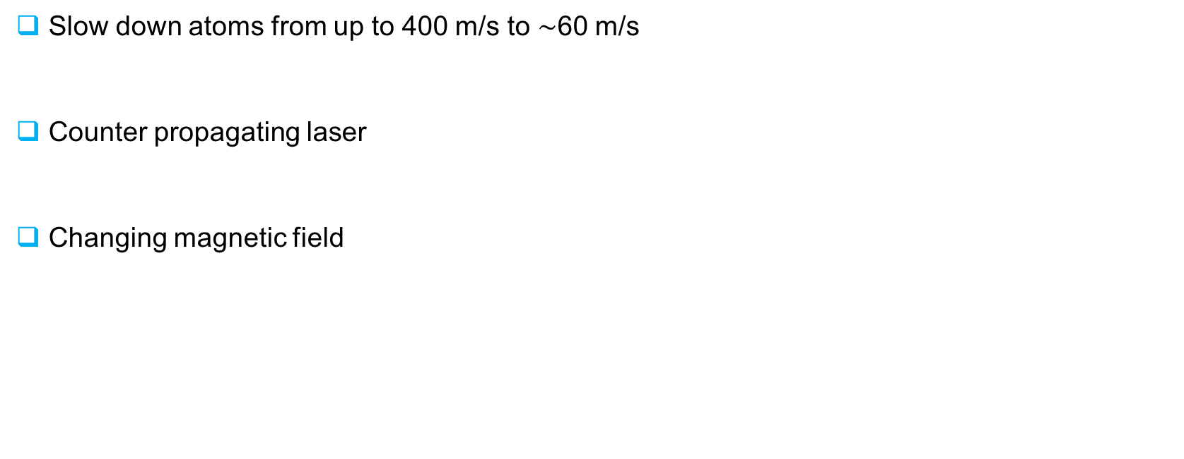
Slowing down atoms
Doppler cooling
Slow down atoms from up to 400 m/s to $\sim$60 m/s
Counter propagating laser
Changing magnetic field

Slide 15
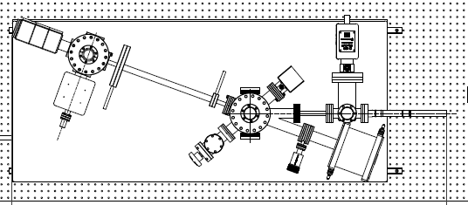
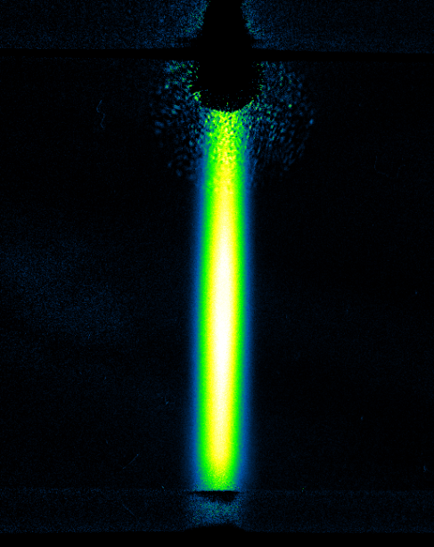
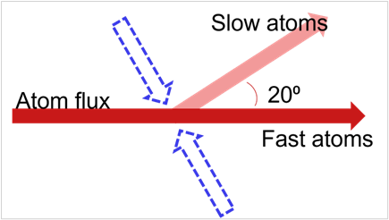
Deflection stage
Separate slow from fast atoms
Set of lasers under 20° angle with atomic flux
Laser
Atoms
Inside glass cell

Slide 16
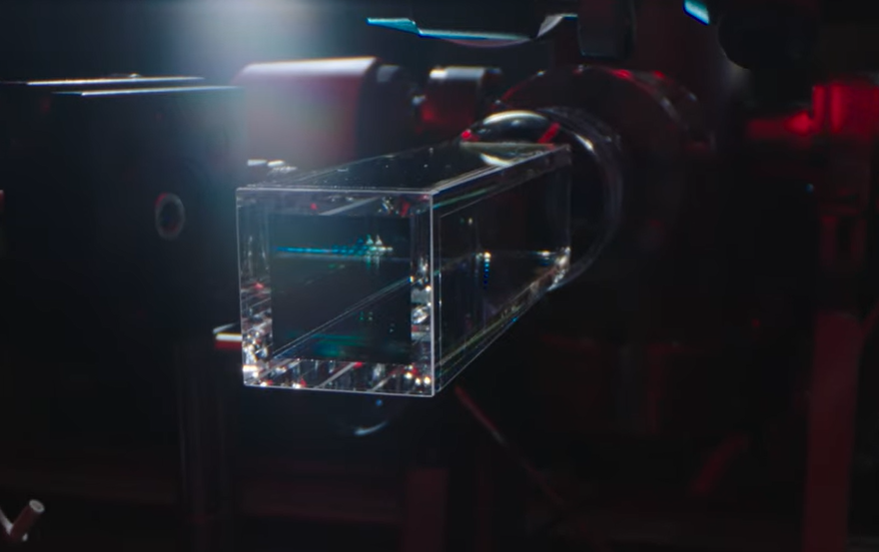
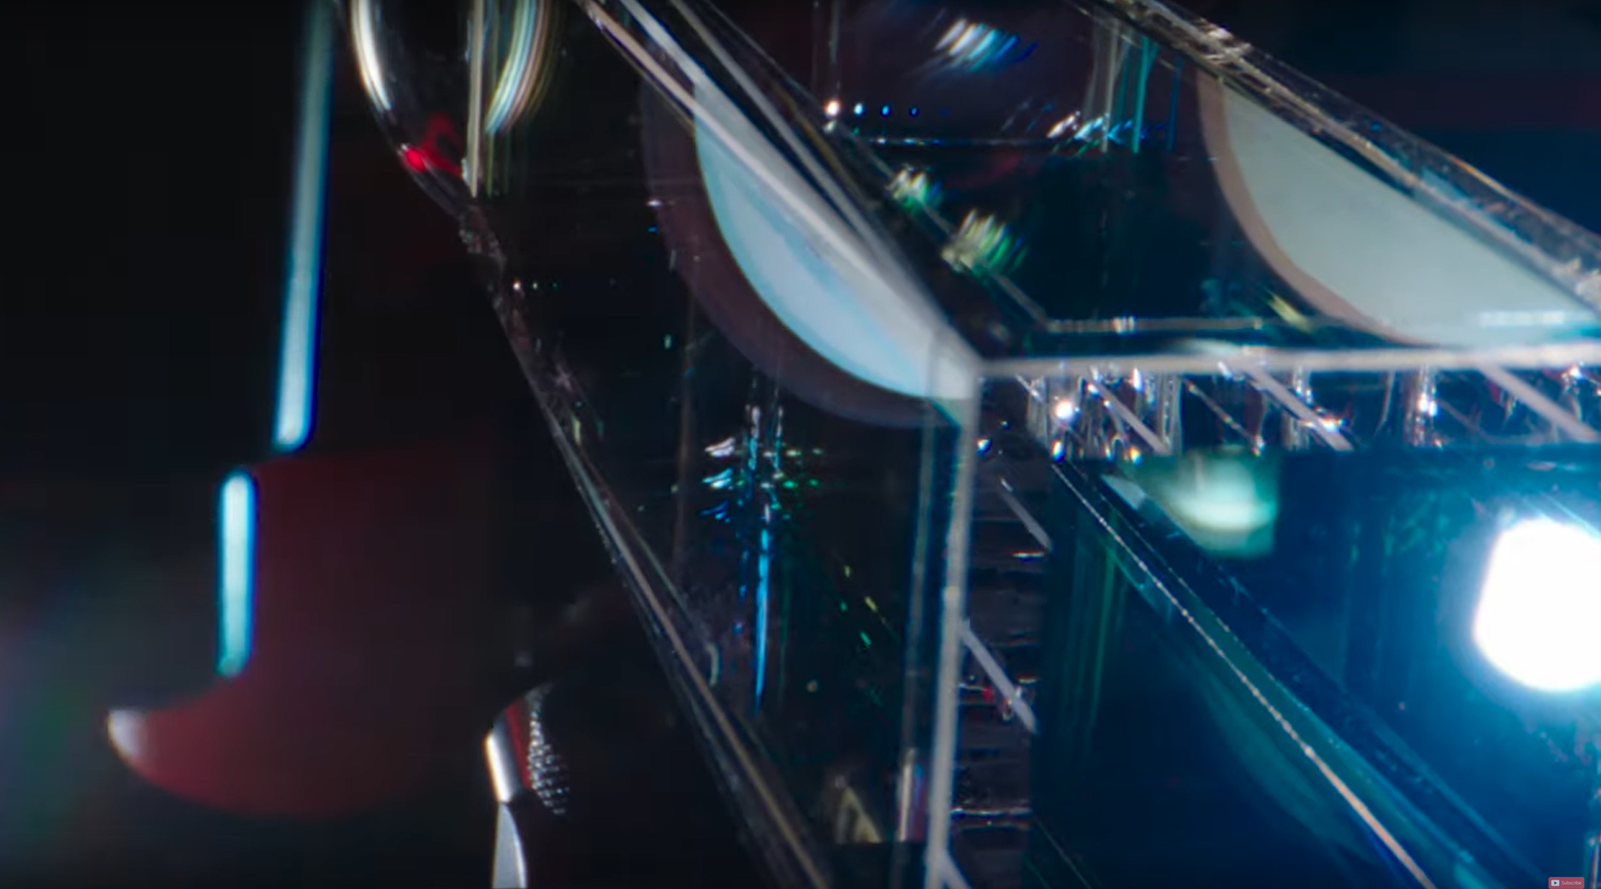
Glass cell
Max. optical access
Optically contacted
Final vacuum; pressure < 10⁻¹¹ mbar
Same as outer space

Slide 17
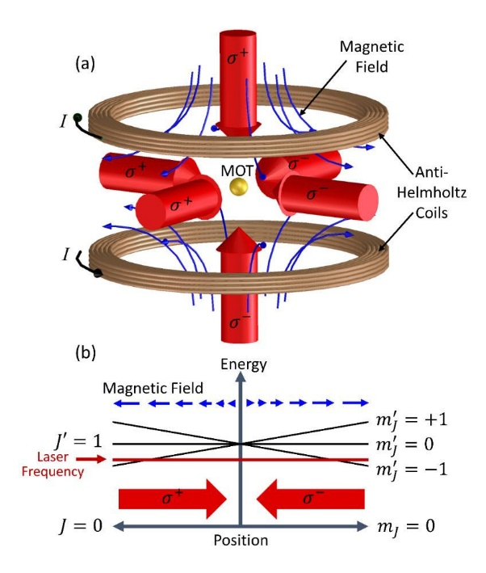

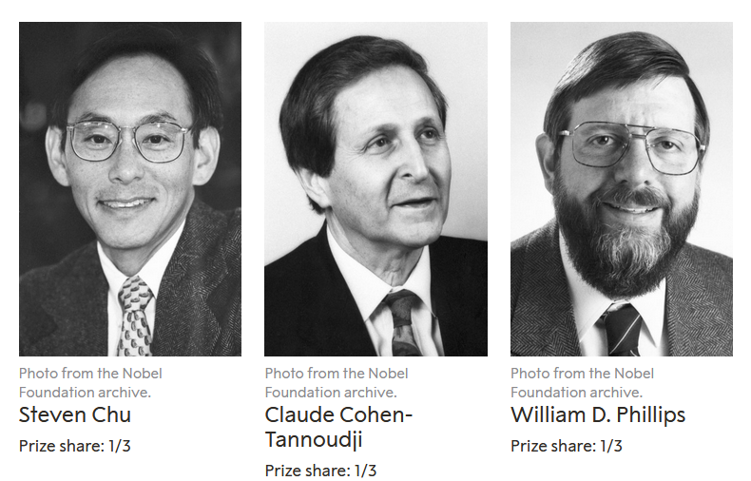
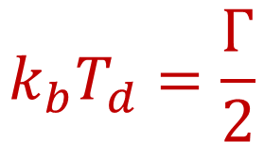
Magneto optical trap
3 sets of counter propagating lasers (circular polarization)
Frequency detuned slightly below resonance
Gradient magnetic field to trap atoms in space
Nobel prize physics 1997!
$$k_{b}T_{d}=\frac{Γ}{2}$$

Slide 18
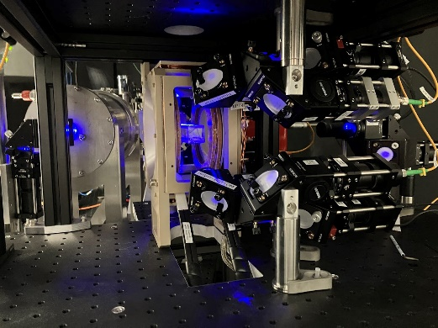
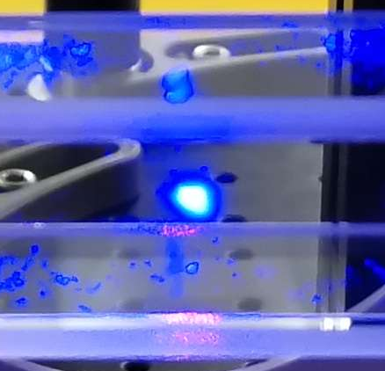
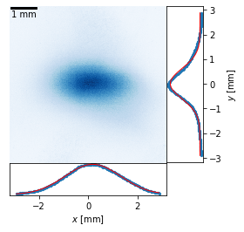
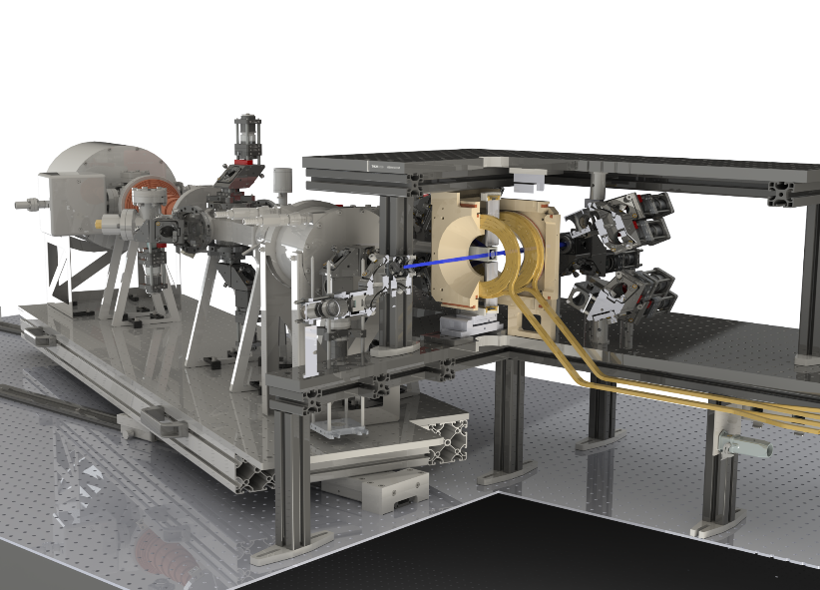
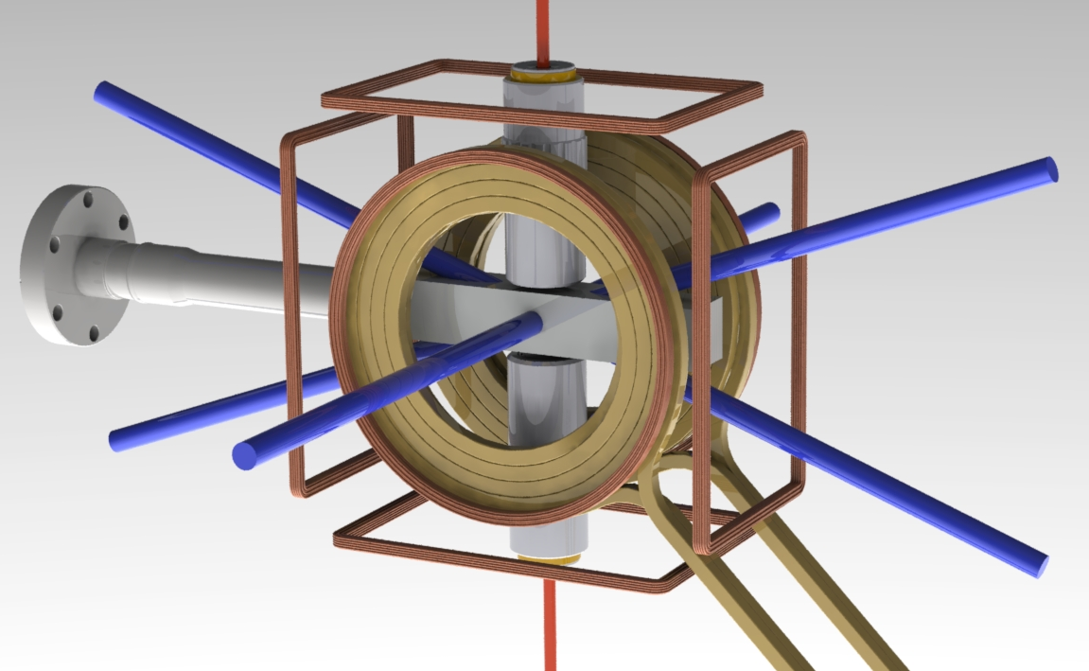
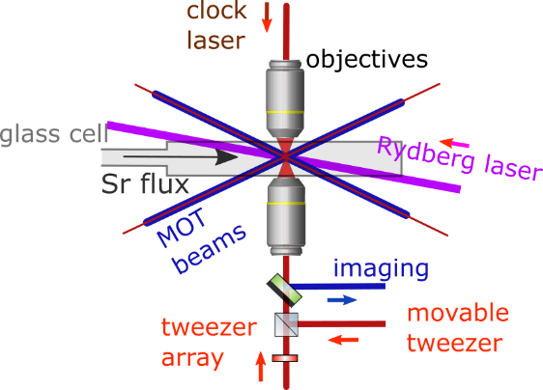
Trapping atoms on the blue transition
Laser beams angled
3 sets of bias coils
Temperature ~ 1 mK

Slide 19
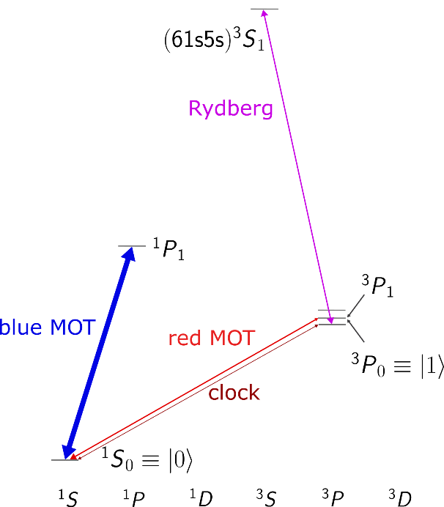
Outlook: red magneto-optical trap
Incredibly narrow line → cool temperatures
Sub-μK temperatures within reach

Slide 20
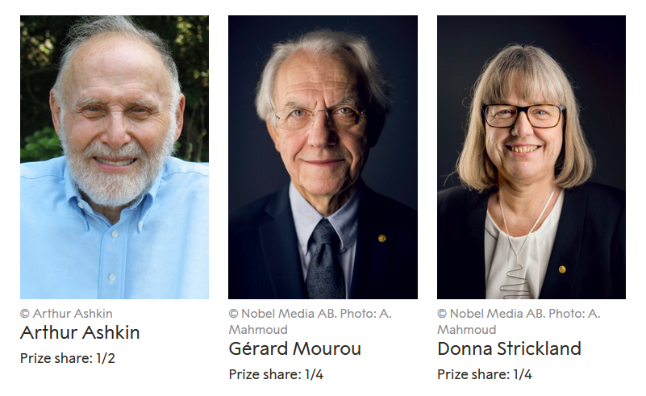




Optical Tweezers
Nobel prize physics 2018!
Focus laser to tiny spot
Atom attracted to max. intensity
Result: dipole potential well used to coherently trap atoms
Nature 561, 79-82 (2018)

Slide 21



Optical tweezers: Single atoms
Overlap in 3D space with atom cloud
Load many atoms in the trap
Kick out atoms in pairs with resonant light
For small volume: 50% chance of loading single atom
Schlosser et al. in Phys. Rev. Lett. 89, 023005 (2002)
Antoine Browaeys: Physics 11, 135, December 2018

Slide 22








Optical tweezers: arrays
Imprint phase mask on laser
Iterate to obtain desired hologram
3D possible!
Can be scaled to 1000s of atoms!
Antoine Browaeys: Physics 11, 135, December 2018

Slide 23



Moving around single atoms
Tweezing and moving one atom
Before
After
Static tweezer
Moving tweezer with one atom

Slide 24

Moving around single atoms
Optimal Transport!!

Slide 25




Schrödinger equation
$$|r〉$$
$$i∂_{t}\left|ψ\right\rangle =H|ψ⟩$$
+ Losses
$$i∂_{t}\left|ψ\right\rangle =\left[H_{trap}+H_{trans}+H_{int}\right]|ψ⟩$$
$$|0〉$$
$$|1〉$$

Slide 26








Laser optical tweezers
$$H_{trap}$$
Gaussian beam potential:
$$U\left(r,z\right)=\frac{U_{0}}{1+z^{2}/z_{R}^{2}}\exp\left(−\frac{2r^{2}}{w_{0}^{2}(1+z^{2}/z_{R}^{2})}\right)$$
$$U_{0}=−α\left(ω_{laser}\right)I_{0}$$
Polarizability
Harmonic oscillator approximation:
By Gaussianbeam.png: en:User:DrBob - Gaussianbeam.png, CC BY-SA 3.0, https://commons.wikimedia.org/w/index.php?curid=6002103

Slide 27




Atom Polarizability
$$H_{trap}$$
Gaussian beam potential:
Magic Wavelength trapping $⇒$ Same trapping potential
$$U\left(r,z\right)=\frac{U_{0}}{1+z^{2}/z_{R}^{2}}\exp\left(−\frac{2r^{2}}{w_{0}^{2}(1+z^{2}/z_{R}^{2})}\right)$$
$$U_{0}=−α\left(ω_{laser}\right)I_{0}$$
Polarizability characterizes susceptibility to electric field
Polarizability of state $|v⟩$:
$$α_{v}\left(ω_{laser}\right)=\frac{2e^{2}}{3\left(2J+1\right)m}\sum_{n}{\frac{\left(E_{n}−E_{v}\right)\left|\left\langle v\right|D\right|n⟩{\left.​\right|}^{2}}{{\left(E_{n}−E_{v}\right)}^{2}−ω_{laser}^{2}}}$$
Polarizability of electron:
$$α_{v}\left(ω_{laser}\right)=−\frac{e^{2}}{mω_{laser}^{2}}$$
Source: Ivaylo Madjarov PhD Thesis (2021)

Slide 28






Atom Polarizability
$$H_{trap}$$
See trap as H.O. with frequency
$$H_{trap}=H_{trap,0}+H_{trap,1}+H_{trap,r}$$
$$H_{trap,j}=\left[\frac{p^{2}}{2m}+\frac{mω_{x,j}^{2}}{2}x^{2}+\frac{mω_{y,j}^{2}}{2}y^{2}+\frac{mω_{z,j}^{2}}{2}z^{2}\right]\left|j\right\rangle \left\langle j\right|$$
Note that for $|r⟩$ we have $U<0$ and thus $ω_{i,r}^{2}<0$, resulting in active repulsion from the trap (anti-trapping)

Slide 29













Optical Bloch Equations
$$H_{trans}$$
$$|e⟩$$
$$Δ$$
$$Γ$$
$$Ω$$
$$\frac{ Γ}{2}$$
$$|g⟩$$
$$R_{sc}=Γρ_{ee}\left(t→∞\right)$$

Slide 30

JUPYTER NOTEBOOK TIME

Slide 31









Light-atom interactions
$$H_{trans}$$
$$|e⟩$$
$$Δ$$
$$H_{eg}=\frac{ℏ}{2}\left(Ωe^{−i\left(\vec{k}⋅\vec{x}−φ\right)}|g⟩⟨e|+Ωe^{i\left(\vec{k}⋅\vec{x}−φ\right)}|e⟩⟨g|\right)−Δ|e⟩⟨e|$$
$$Γ$$
$$Ω$$
$$\vec{k}⋅\vec{x}=\sqrt{\frac{ℏ}{2mω}}\left|k\right|\left(a^{†}+a\right)=η\left(a^{†}+a\right)$$
Photon recoil:
$$|g⟩$$
Lamb-Dicke regime $η≪1$: no motional excitation
Rabi oscillation:
$$P_{e}\left(t\right)=\frac{Ω^{2}}{Ω^{2}+Δ^{2}}\sin^{2}\left(\sqrt{Ω^{2}+Δ^{2}}t\right)$$

Slide 32












Clock Transition in Sr88
$$H_{trans}$$
$$2$$
$g_{l}≈1−\frac{m_{e}}{m_{Sr88}}$
$g_{s}≈2$
$μ_{B}=\frac{\text{e}ℏ}{2m_{e}}≈\text{9.27}⋅{10}^{−24}$ J/T
$≈2π⋅5.6⋅{10}^{12}$ Hz
$$B=0.1 T$$
$$c=\frac{λω}{2π}$$
$$c=2.99⋅{10}^{8}$$
$≈2π⋅7.4⋅{10}^{3}$ Hz
$ℏ≈6.626⋅{10}^{−34}/2π$ Js
$$w_{laser}={10}^{−6} m$$
$$I=\frac{P}{A_{laser}}$$
$$P=50 ∗{10}^{−3}W$$
Calculate the speed of
the Quantum Computer
(e.g. calculate $Ω$)

Slide 33
JUPYTER NOTEBOOK TIME

Slide 34



Two photon transition
$$H_{trans}$$
Three level system
Pump laser (p) and coupling laser (c)
$H_{L−A }=H_{L−A }^{(p)}$+ $H_{L−A }^{(c)}$
$$=\frac{ℏ}{2}\left(Ω_{p}e^{iφ_{p}}\left|0\right\rangle \left\langle 2\right|+Ω_{p}^{∗}e^{−iφ_{p}}\left|2\right\rangle \left\langle 0\right|+Ω_{c}e^{iφ_{c}}\left|1\right\rangle \left\langle 2\right|+Ω_{c}^{∗}e^{−iφ_{c}}\left|2\right\rangle \left\langle 1\right|\right)$$
$$H_{det}=−ℏδ|1⟩⟨1|−ℏΔ|2⟩⟨2|$$
$$H_{loss}=\left(γ_{20}|0⟩⟨0|+γ_{21}|1⟩⟨1|\right)ρ_{22}−\frac{γ_{20}+γ_{21}}{2}\left(|2⟩⟨2|ρ+ρ|2⟩⟨2|\right)$$

Slide 35




Two photon transition
$$H_{L−A }=\frac{ℏ}{2}\left(Ω_{p}e^{iφ_{p}}\left|0\right\rangle \left\langle 2\right|+Ω_{p}^{∗}e^{−iφ_{p}}\left|2\right\rangle \left\langle 0\right|+Ω_{c}e^{iφ_{c}}\left|1\right\rangle \left\langle 2\right|+Ω_{c}^{∗}e^{−iφ_{c}}\left|2\right\rangle \left\langle 1\right|\right)$$
$$H_{det}=−ℏδ|1⟩⟨1|−ℏΔ|2⟩⟨2|$$
$$H_{loss}=\left(γ_{20}|0⟩⟨0|+γ_{21}|1⟩⟨1|\right)ρ_{22}−\frac{γ_{20}+γ_{21}}{2}\left(|2⟩⟨2|ρ+ρ|2⟩⟨2|\right)$$
$$iℏ∂_{t}ρ=\left[H,ρ\right]=\left[H_{L−A}+H_{det}+H_{loss},ρ\right]$$
$$\dot{ρ_{00}}=−\frac{i}{2}\left(Ω_{p}ρ_{20}−Ω_{p}^{∗}ρ_{02}\right)+γ_{20}ρ_{22}$$
$$\dot{ρ_{11}}=−\frac{i}{2}\left(Ω_{c}ρ_{21}−Ω_{c}^{∗}ρ_{12}\right)+γ_{21}ρ_{22}$$
$$\dot{ρ_{22}}=−\dot{ρ_{00}}−\dot{ρ_{11}}$$
$$\dot{ρ_{01}}=−iδρ_{01}−\frac{i}{2}\left(Ω_{p}ρ_{21}−Ω_{c}^{∗}ρ_{02}\right)$$
$$\dot{ρ_{02}}=−iΔρ_{02}−\frac{i}{2}\left(Ω_{p}{(ρ}_{22}−ρ_{00})−Ω_{c}ρ_{01}\right)−\frac{γ_{20}+γ_{21}}{2}ρ_{22}$$
$$\dot{ρ_{12}}=−i\left(Δ−δ\right)ρ_{12}−\frac{i}{2}\left(Ω_{c}{(ρ}_{22}−ρ_{11})−Ω_{p}ρ_{10}\right)−\frac{γ_{20}+γ_{21}}{2}ρ_{22}$$
$$H_{trans}$$

Slide 36




Two photon transition
$$\dot{ρ_{00}}=−\frac{i}{2}\left(Ω_{p}ρ_{20}−Ω_{p}^{∗}ρ_{02}\right)+γ_{20}ρ_{22}$$
$$\dot{ρ_{11}}=−\frac{i}{2}\left(Ω_{c}ρ_{21}−Ω_{c}^{∗}ρ_{12}\right)+γ_{21}ρ_{22}$$
$$\dot{ρ_{22}}=−\dot{ρ_{00}}−\dot{ρ_{11}}$$
$$\dot{ρ_{01}}=−iδρ_{01}−\frac{i}{2}\left(Ω_{p}ρ_{21}−Ω_{c}^{∗}ρ_{02}\right)$$
$$ρ_{02}=\frac{Ω_{p}}{2Δ}ρ_{00}+\frac{Ω_{c}}{2Δ}ρ_{01}$$
$$ρ_{12}=\frac{Ω_{c}}{2Δ}ρ_{11}+\frac{Ω_{p}}{2Δ}ρ_{10}$$
Adiabatic elimination
$$\dot{ρ_{00}}=i\frac{Ω_{p}^{∗}Ω_{c}}{4Δ}ρ_{01}−i\frac{Ω_{p}Ω_{c}^{∗}}{4Δ}ρ_{10}$$
$$\dot{ρ_{11}}=−i\frac{Ω_{p}^{∗}Ω_{c}}{4Δ}ρ_{01}+i\frac{Ω_{p}Ω_{c}^{∗}}{4Δ}ρ_{10}=−\dot{ρ_{00}}$$
$$\dot{ρ_{01}}=−i\left(δ+\frac{{\left|Ω_{p}\right|}^{2}−{\left|Ω_{c}\right|}^{2}}{4Δ}\right)ρ_{01}−i\frac{Ω_{p}Ω_{c}^{∗}}{4Δ}(ρ_{11}−ρ_{00})$$
$$H_{trans}$$
Effectively a two-level system!

Slide 37






Two photon transition
$$\dot{ρ_{00}}=i\frac{Ω_{p}^{∗}Ω_{c}}{4Δ}ρ_{01}−i\frac{Ω_{p}Ω_{c}^{∗}}{4Δ}ρ_{10}$$
$$\dot{ρ_{11}}=−i\frac{Ω_{p}^{∗}Ω_{c}}{4Δ}ρ_{01}+i\frac{Ω_{p}Ω_{c}^{∗}}{4Δ}ρ_{10}=−\dot{ρ_{00}}$$
$$\dot{ρ_{01}}=−i\left(δ+\frac{{\left|Ω_{p}\right|}^{2}−{\left|Ω_{c}\right|}^{2}}{4Δ}\right)ρ_{01}−i\frac{Ω_{p}Ω_{c}^{∗}}{4Δ}(ρ_{11}−ρ_{00})$$
Effectively a two-level system!
$${i∂_{t}ρ}_{eff}=[H_{eff},ρ_{eff}]$$
$$Ω=\frac{Ω_{p}Ω_{c}^{∗}}{2Δ}$$
$$H_{eff}=\frac{ℏ}{2}\left(\begin{matrix}0 & Ω \\ Ω^{∗} & −δ′\end{matrix}\right)$$
$$δ^{′}=δ+\frac{{|Ω}_{p}{\left.​\right|}^{2}−{\left|Ω_{c}\right|}^{2}}{4Δ}$$
$$ρ_{eff}=\left(\begin{matrix}ρ_{00} & ρ_{01} \\ ρ_{10} & ρ_{11}\end{matrix}\right)$$
$$H_{trans}$$

Slide 38







Two photon transition
$${i∂_{t}ρ}_{eff}=[H_{eff},ρ_{eff}]$$
$$Ω=\frac{Ω_{p}Ω_{c}^{∗}}{2Δ}$$
$$H_{eff}=\frac{ℏ}{2}\left(\begin{matrix}0 & Ω \\ Ω^{∗} & −δ′\end{matrix}\right)$$
$$δ^{′}=δ+\frac{{|Ω}_{p}{\left.​\right|}^{2}−{\left|Ω_{c}\right|}^{2}}{4Δ}$$
$$ρ_{eff}=\left(\begin{matrix}ρ_{00} & ρ_{01} \\ ρ_{10} & ρ_{11}\end{matrix}\right)$$
Note that:
Effective Rabi frequency $Ω \sim \frac{1}{Δ}$
Spontaneous emission $\sim \frac{1}{Δ^{2}}$
So for good two-photon transitions: high intensity, high detuning
$$H_{trans}$$

Slide 39









Rydberg interactions
$$H_{int}$$
Förster defect
Dipole-dipole
Van der Waals

Slide 40

Rydberg interactions
$$H_{int}$$
$$|r〉$$
Van der Waals
$$H_{int}=−\sum_{ij}{\frac{C_{6}}{R_{ij}}|rr⟩⟨rr|}$$
$$|1〉$$
$$|0〉$$

Slide 41











Rydberg blockade
$$H_{int}$$
$$H=\frac{1}{2}\left(\begin{matrix}0 & Ω \\ Ω & 2Δ\end{matrix}\right)$$
$\left|ψ_{g}\right\rangle =\frac{1}{α}\left(\left|g\right\rangle −\frac{Ω}{Δ+\sqrt{Δ^{2}+Ω^{2} }}|r⟩\right)≈\left|g\right\rangle +\frac{Ω}{2Δ}\left|r\right\rangle =\left|g\right\rangle +β|r⟩$
Intuitively, for an interacting system with
$$H_{int}=V_{rr}|rr⟩⟨rr|$$
$$U_{2}−U_{1}$$
However, in the basis $\left\{\left|gg\right\rangle ,\left(\left|gr\right\rangle +\left|rg\right\rangle \right)/√2,|rr⟩ \right\}$
(note that the anti symmetric $\left(\left|gr\right\rangle −\left|rg\right\rangle \right)/√2$ is not coupled)
Show these values for $U_{1}$ and $U_{2}$

Slide 42
JUPYTER NOTEBOOK TIME

Slide 43






Rydberg losses
$$Losses$$
$$i{ℏ∂}_{t}ρ=\left[H,ρ\right]−Γρ$$
$$Γ=Γ_{BBR}+Γ_{stray,elec} (+Γ_{anti−trap })$$
Black body radiation (BBR)
Stray Electric Field

